Slide 1
BIODIVERSITY CAPSTONE PROJECT - INVESTIGATING PROTECTED SPECIES
Christian Yovo
via
CodeAcademy.com

Slide 2
Part I: Data background info.
species_info.csv file
Dataframe/ Table with 5,824 observations and 4 variable / columns: category, scientific_name, common_names and conservation_status.
category 5824 non-null object
scientific_name 5824 non-null object
common_names 5824 non-null object
conservation_status 191 non-null object

Slide 3
Inspection of DataFrame
The number of different species is: 5541
The types of species are: ['Mammal' 'Bird' 'Reptile' 'Amphibian' 'Fish' 'Vascular Plant'
'Nonvascular Plant']
The different values of conservation status are: [nan 'Species of Concern' 'Endangered' 'Threatened' 'In Recovery']

Slide 4
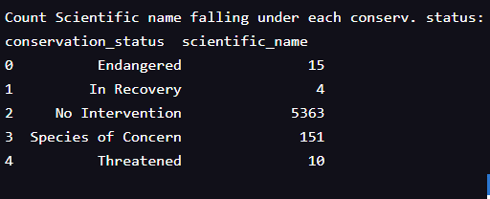
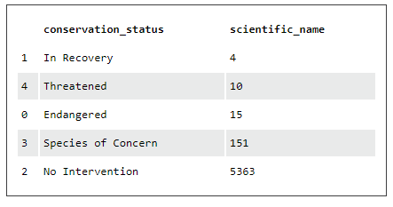
Inspection of DataFrame (cont’d)
Number of each species that falls into these conservation statuses:
Sorted

Slide 5
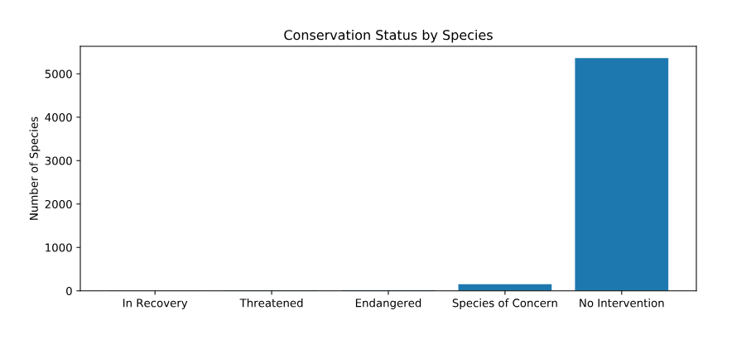
Plotting Conservation Status by Species: Bar Chart

Slide 6
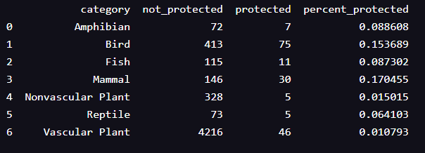
Are certain types of species more likely to be endangered?
There’s a low percentage of species being protected in each categories. All categories are at risk. It looks like Mammals are more likely to be endangered than Birds, but is it a significant difference? We can do a significance test to see if this statement is true. In this test, our null hypothesis is that this difference is due to chance.

Slide 7
Are certain types of species more likely to be endangered?
Data numerical & categorical. Several pieces of data being compared.
Chi-Squared Test for Significance using a contingency table
This difference isn't significant!
This difference is significant!

Slide 8
Final Thoughts on Protected Species
Are certain types of species more likely to be endangered?
Initially noticed a slight difference in the percentages of birds and mammals that fall into a protected category. Null hypothesis is that this difference was a result of chance.
Ran chi-squared test, found a p-value of ~0.688: can conclude that difference between percentages of protected birds and mammals is not significant and is a result of chance.
However, when compared percentages of protected reptiles and mammals and ran the same chi-squared test, found p-value of ~0.038, which is significant.
Therefore, can conclude that certain types of species are more likely to be endangered than others.

Slide 9
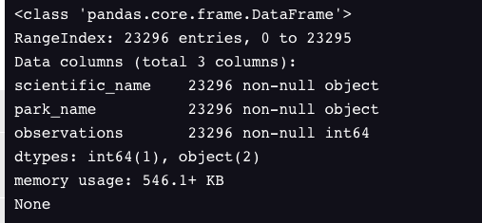
Part II: Data Background info.
observations.csv file
Dataframe/ Table with 23,296 observations and 3 variable / columns: scientific_name, park_name, observations

Slide 10
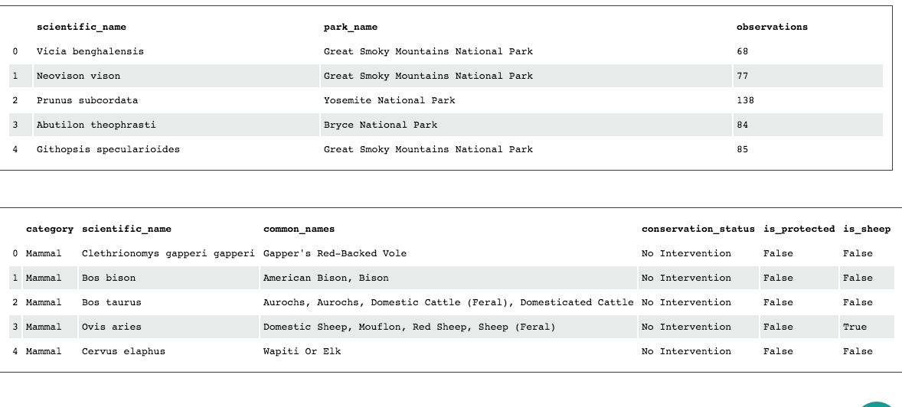
Analyzing “Observations” and “Species” DFs
Notes:
The top DataFrameshows entries of the “observations.csv” file. The bottom DataFrame shows a modified version of the original “species” DataFrame. The latter has two (2) additional columns which give us Boolean information on whether a species is protected, and whether the species has the word “Sheep” in its common_names’ column.

Slide 11
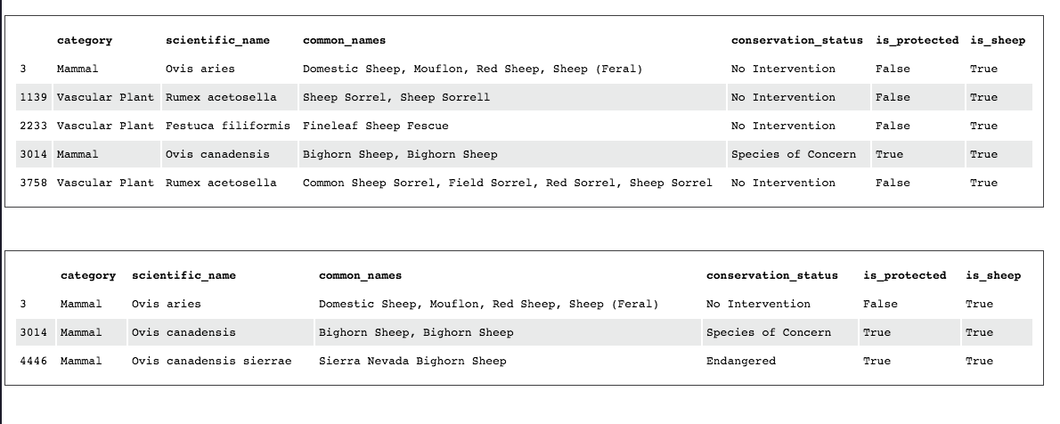
Analyzing “Species” DFs: In Search of Sheep
Notes:
An aggregate script was written to select the rows of species where is_sheep is True: this creates the top DataFrame.
Another script selects the rows of species where is_sheep is True and category is Mammal: this can be seen in the bottom DataFrame.

Slide 12
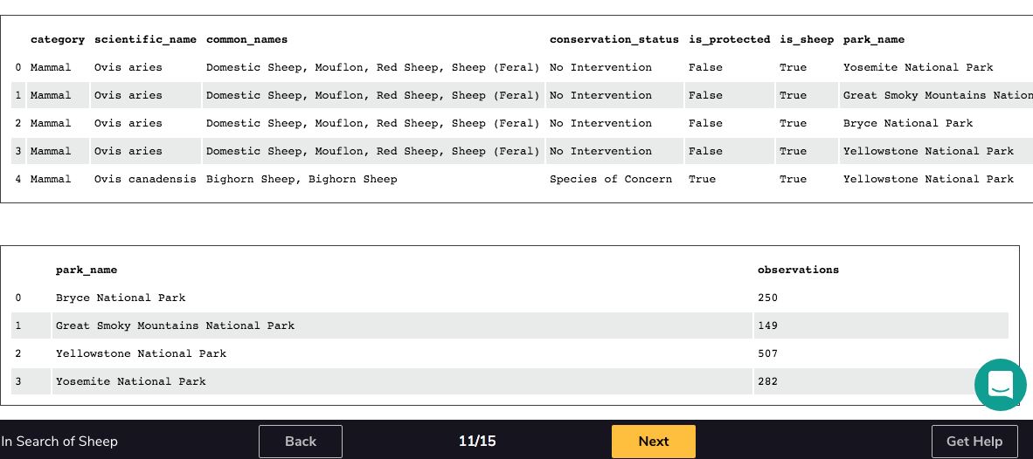
Merging Sheep and Observation DataFrames
Notes:
We merged DataFrames of the sheep_species with observations to get the first DataFrame above, which groups all the columns of the species and those of observations.
In the bottom DataFrame, we calculated the total sheep sightings, across all three species, that were made at each national park. We used groupby to get the sum of observsations for each park_name.

Slide 13
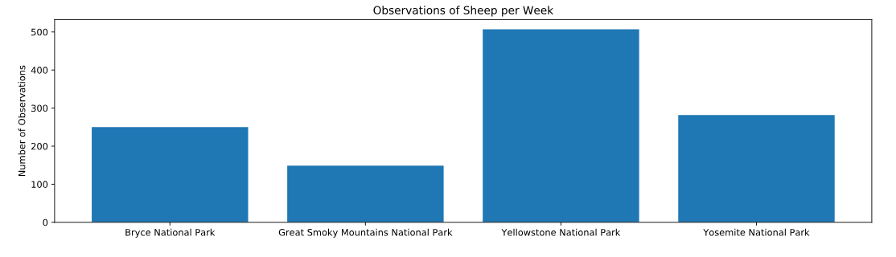
Plotting Sheep Sightings: Bar chart

Slide 14
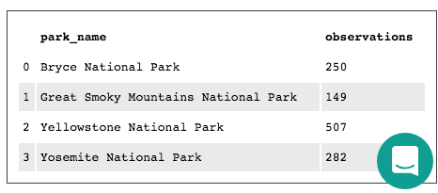
Part III: Foot and Mouth Reduction Effort
Sample size?
Data being used is Obs_by_park table (see below)
w
Goal to detect >5% reduction at Yellowstone from 15% contraction at Bryce
Notes:
What sample size of sheep is required to observe from each park to be confident that their foot and mouth percentages are significant?
It was recorded that 15% of sheep at Bryce National Park have foot and mouth disease.
Would like to detect reductions of at least 5 percentage points. For instance, if 10% of sheep in Yellowstone National Park have foot and mouth disease, we’d like to be able to know this, with confidence.

Slide 15
Sample Size Determination (cont’d)
Baseline percentage of this sample size determination: 15%
Minimum Detectable Effect: (100 * 5)/15 → 33.3%
Using a sample size calculator: a baseline conversion rate of 15%, a minimum detectable effect of 33.3%, the default level of significance of 90%, we obtain a sample_size_per_variant of 870.
To determine the length of observation (in weeks) at each park, we use the number of observations per park (from the obs_per_park table) and divide it into the value of the sample_size_per_variant.
yellowstone_weeks_observing = sample_size_per_variant / 507.0 → 870/507
bryce_weeks_observing = sample_size_per_variant / 250.0 → 870/250
Notes:
"Minimum Detectable Effect" is a percent of the baseline, so if we wanted to observe an x% change with confidence, our minimum detectable effect would be equal to 100 * x / baseline.

Slide 16
Foot and Mouth Reduction Effort - Final Thoughts
Given a baseline of 15% occurrence of foot and mouth disease in sheep at Bryce National Park, we found that if researchers wanted to be sure that a > = 5% drop in observed cases of foot and mouth disease in the sheep at Yellowstone was significant they would have to observe at least 870 sheep.
Then, using the observation data we analyzed, mainly the minimum sample size aforementioned, we found that this would take approximately one week of observing in Yellowstone to see that many sheep, or approximately two weeks in Bryce to see that many sheep.
Notes:
Thanks to CodeAcademy.com

